Slide 1
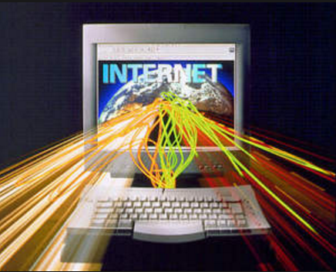


How technology affects workers ?
94% of jobholders are internet users

Slide 2
Email and the internet are deemed the most important communications and information tools among online workers
Expand the number of people outside of their company they communicate with—51% of these internet-using workers say this.
Allow them more flexibility in the hours they work—39% of online workers say this.
Increase the amount of hours they work—35% of online workers say this.

Slide 3
Social media and the work place
The survey asked Americans who are employed full- or part-time about eight different ways they might use social media while on the job and found that:
34% ever use social media while at work to take a mental break from their job
27% to connect with friends and family while at work
24% to make or support professional connections
20% to get information that helps them solve problems at work
17% to build or strengthen personal relationships with coworkers
17% to learn about someone they work with
12% to ask work-related questions of people outside their organization
12% to ask such questions of people inside their organization"

Slide 4
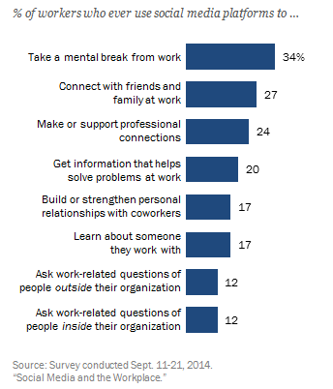
Workers use social media at work for many reasons; taking a mental break is one of the most common

Slide 5

How Technology has changed workplace communication?
"Collaboration used to happen in board rooms with whiteboards and bagels. Today, it’s on documents being edited by multiple people all over the world at the same time. It’s sharing screen data and chatting over video."

Slide 6


Blogs: Communication in the Workplace
Blogs have created new ways of communicating within the workplace. Executives and entry level employees
are now able to share ideas and work together on projects.

Slide 7

Blogs: Communication in health
Medical professionals can now directly share information with patients for health tips, advice, and professional direction.

Slide 8
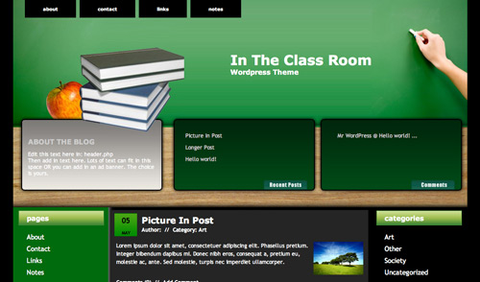

Blogs: Communication in Education
Teachers are now able to communicate effectively with students, facility, and parents. Feedback, news, and happenings are able to be easily shared amongst all areas of education.

Slide 9
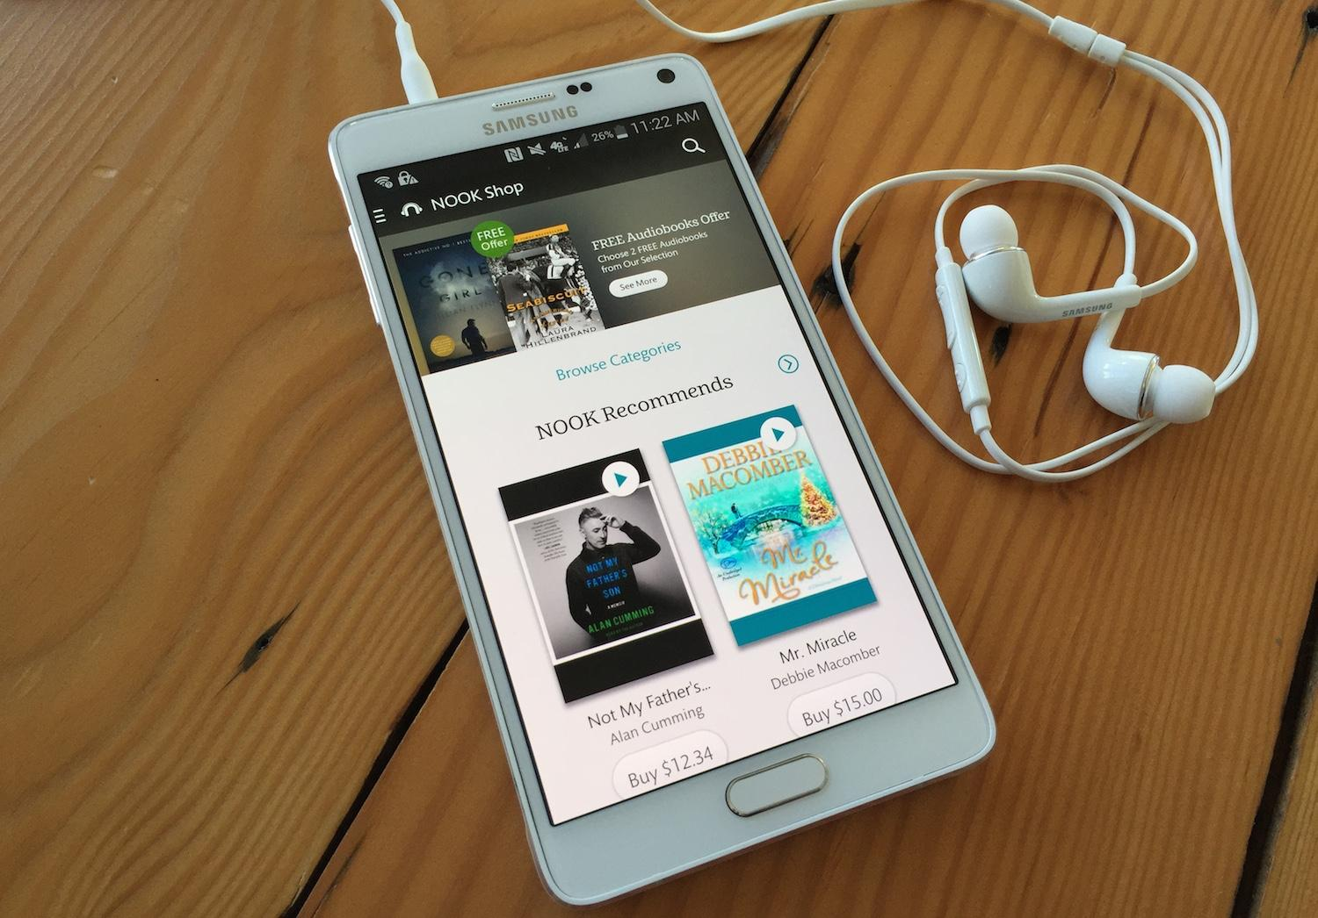
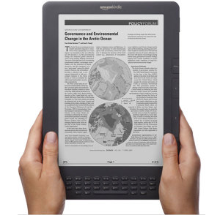
Audiobooks & eBooks
These are some relatively new forms of technology that are redefining literature and how we experience it.
These two variations on traditional books are changing the norms of literature.
Great for people on the go
Thousands of books available
Listen while doing chores or commuting
Easy to access with tablet or smartphone

Slide 10
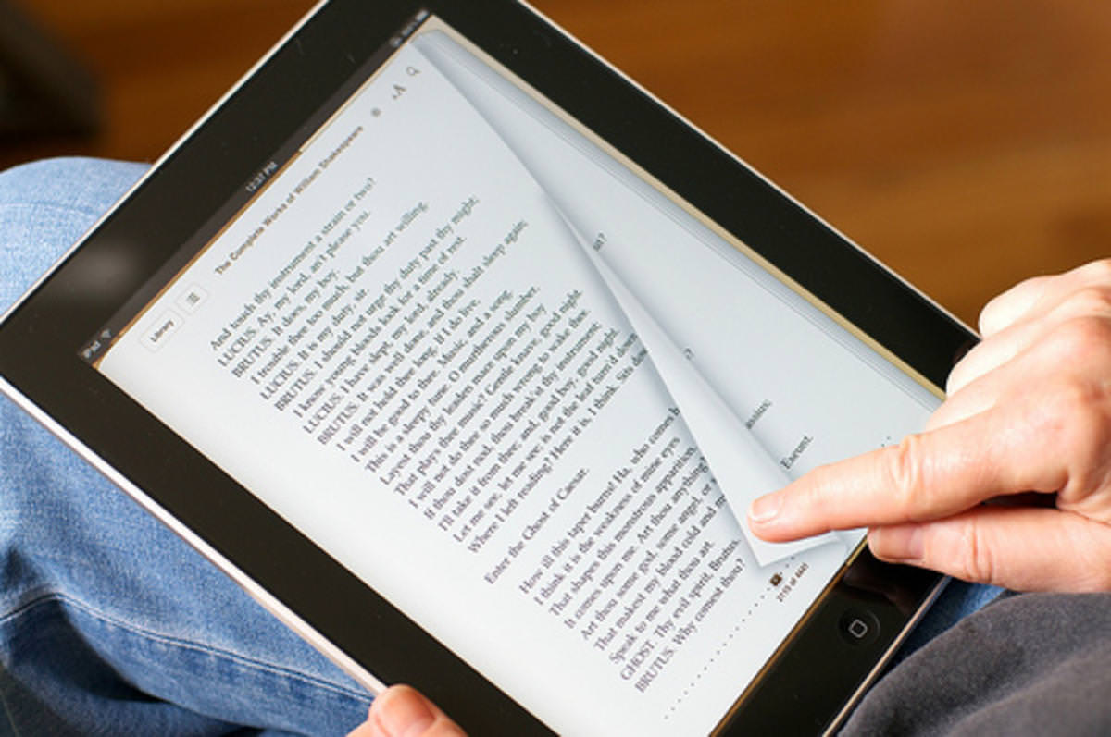

eBooks
Thousands of titles at your fingertips
Easier for students
Takes up less space
Easy to access with tablet or smartphone

Slide 11

Audiobooks & eBooks
Changes the way we experience literature
Makes the whole reading experience easier and more enjoyable
Could change the future of reading permanently making physical books a thing of the past

Slide 12
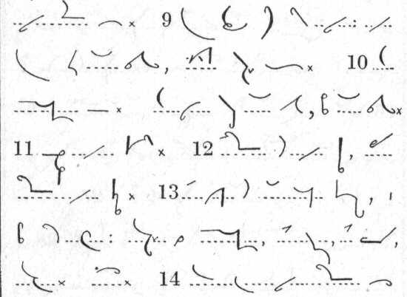
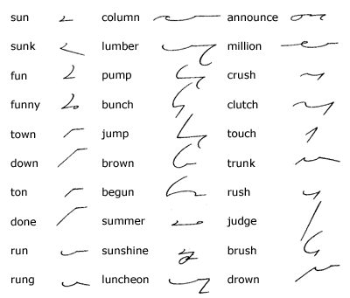
Types of Shorthand
Pitman Shorthand
Gregg Shorthand
Introduced in 1837 Developed by Sir Isaac Pitman
Used in the UK and U.S.
Introduced in 1888
Developed by John Robert Greg
Used in the U.S.

Slide 13
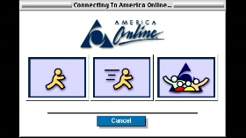


Computer Programs shifted Shorthand to Acronyms
AOL and All E-mail Internet Services
Text messaging Apps
Social Media Accounts

Slide 14
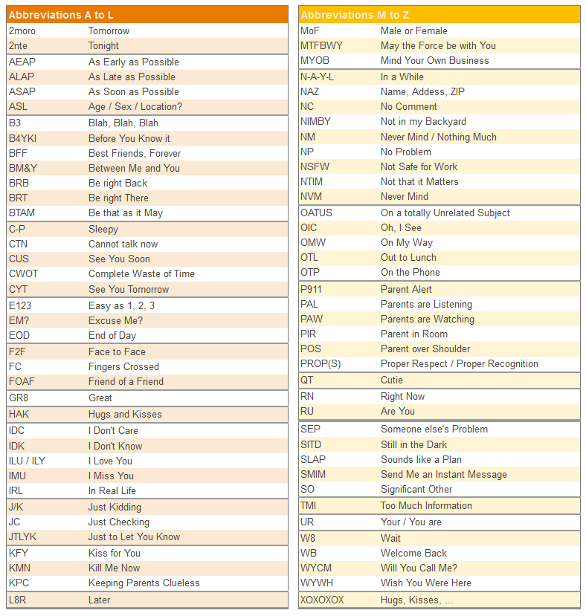
Technologies Version of Shorthand

Slide 15
References
PURCELL, K. & RAINIE, L. (2016). Technology’s Impact on Workers. Pew Research Center: Internet, Science & Tech. Retrieved 26 October 2016, from http://www.pewinternet.org/2014/12/30/technologys-impact-on-workers/
OLMSTEAD, K., LAMPE, C., & ELLISON, N. (2016). Social Media and the Workplace. Pew Research Center: Internet, Science & Tech. Retrieved 26 October 2016, from http://www.pewinternet.org/2016/06/22/social-media-and-the-workplace/
Burg, N. (2016). UnifyVoice: How Technology Has Changed Workplace communication.Forbes. Retrieved 26 October 2016, from http://www.forbes.com/sites/unify/2013/12/10/how-technology-has-changed-workplace- communication/#39acfd7d4562

Slide 16
http://consumster.com/wp-content/uploads/2014/10/amazon-kindle-dx-graphite-ebook-reader-300x294.jpg
http://s3.amazonaws.com/digitaltrends-uploads-prod/2014/11/Nook-Audiobook.jpg
https://www.monergism.com/sites/default/files/content_images/e-books.jpg
https://cdn3.geckoandfly.com/wp-content/uploads/2013/03/iPadEbook.jpg
http://w1oge2lbo9m15zqub1zofhpn.wpengine.netdna-cdn.com/wp-content/uploads/2012/12/bigstock-E-book-reader-Books-and-table-30660962.jpg

